Slide 1
Delta Hedging with Black-Scholes

Slide 2
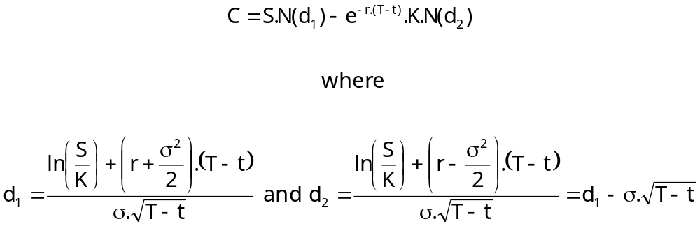

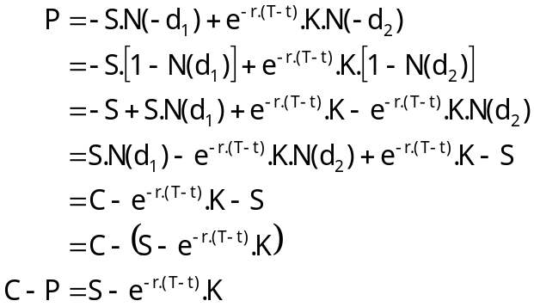
The Black-Scholes Option Pricing Model
2
Value of a European Call option on a stock that pays no dividends:
Value of a European Put option on a stock that pays no dividends:
Put-Call Parity:
Notes:
2

Slide 3





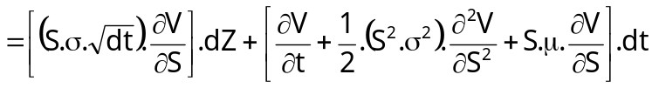
Deriving the Black-Scholes PDE
3
Assume Geometric Brownian Motion:
Construct the Hedge Portfolio:
(hence, changes in the value of the Hedge Portfolio):
Recall the rules of Itô Calculus:
Expand V(S+dS, t+dt) using Taylor Series:
(simplify: observe Itô and substitute in GBM):
Notes:
3

Slide 4
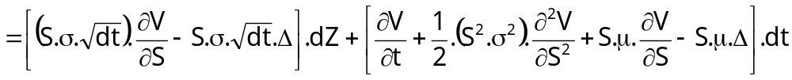

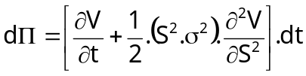

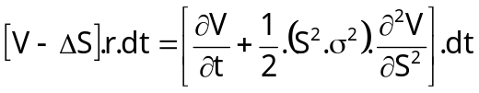

Deriving the Black-Scholes PDE
- cont.
4
So changes in the value of the Hedge Portfolio are:
Letting results in:
So letting means the Hedge Portfolio must earn the risk-free rate of return ( ):
Which simplies (after substitution) to the Black-Scholes PDE:
Notes:
4

Slide 5
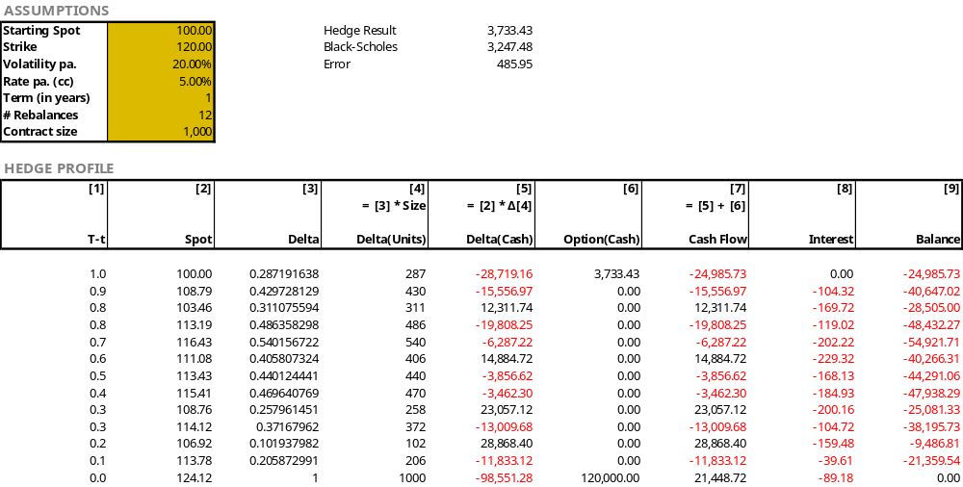
Delta Hedging
- Example
5
Notes:
5

Slide 6
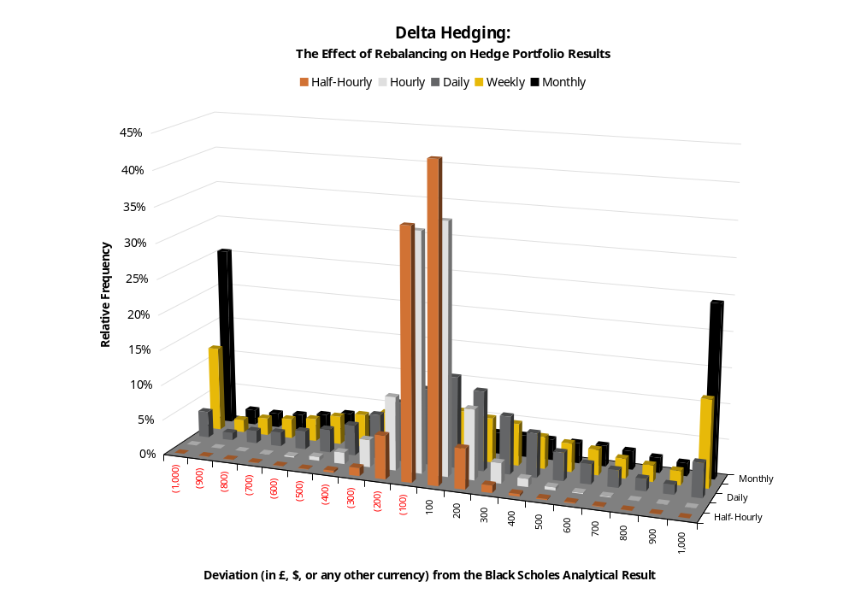
Delta Hedging
- Simulation
6
Notes:
6

Slide 7
The Black-Scholes Option Pricing Model (“BSOM”)
7
Delta hedging is a useful tool to help understand the BSOM:
  delta hedging: dt vs Δt
  transaction costs?
  is GBM the best model (for the underlying)?
  constant r and constant σ?
  options written on non-traded assets?
Implied Volatility
  “the wrong number in the wrong formula to the get the right price”?
Notes:
7

Slide 8
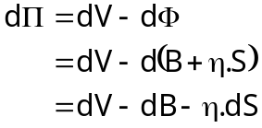
Addendum I
Discrete Time Hedging Error
8
In the previous derivation we used a Hedge Portfolio consisting of:
  A short position of 1 in the (call) option, V; and
  A long position of Δ in the underlying, S:
We now consider the case where our ‘long position’ is a self-financing Replication Portfolio consisting of:
  A position (long or short) of 1 in the risk free asset, B; and
  A position (long or short) of η in the underlying, S:
Such a portfolio is self-financing in that either B or S can be bought or sold in sufficient quantity so as to ensure the sale of one finances the purchase of the other.
The dynamics of our hedge now become:
Notes:
8

Slide 9
Addendum II
Deriving our Black-Scholes results using a Replication Portfolio
9
In the previous derivation we used a Hedge Portfolio consisting of:
  A short position of 1 in the (call) option, V; and
  A long position of Δ in the underlying, S:
We now consider the case where our ‘long position’ is a self-financing Replication Portfolio consisting of:
  A position (long or short) of 1 in the risk free asset, B; and
  A position (long or short) of η in the underlying, S:
Such a portfolio is self-financing in that either B or S can be bought or sold in sufficient quantity so as to ensure the sale of one finances the purchase of the other.
The dynamics of our hedge now become:
Notes:
9

Slide 10


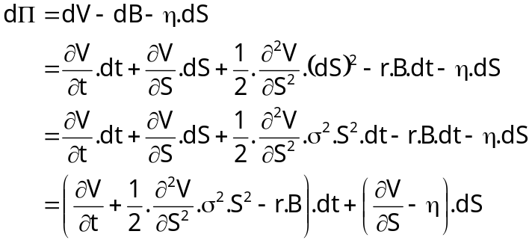


Addendum II
Deriving our Black-Scholes results using a Replication Portfolio – cont.
10
But we know that B grows at the risk free rate:
And we also know from our Taylor Series expansion of dV on slide 3:
Hence, our hedge dynamics become:
If we assume (as before) that we let then we eliminate the risky part of the portfolio (dS).
As such, in the absence of arbitrage, the hedge must grow at the risk free rate:
Notes:
10

Slide 11
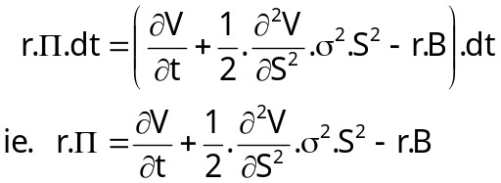

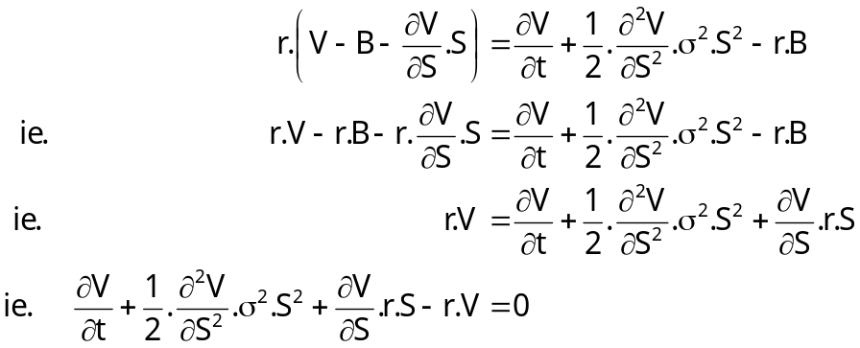
Addendum II
Deriving our Black-Scholes results using a Replication Portfolio – cont.
11
So our hedge dynamics are:
But and so:
Which is the Black-Scholes PDE.
Notes:
11

