Slide 1

Fixed Income Analytics
Hammond Mason

Slide 2
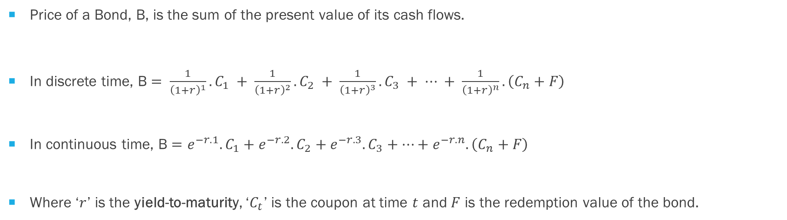
Price of a Bond
Price of a Bond, B, is the sum of the present value of its cash flows.
In discrete time, B $= \frac{1}{{\left(1+r\right)}^{1}}.C_{1} + \frac{1}{{\left(1+r\right)}^{2}}.C_{2} + \frac{1}{{\left(1+r\right)}^{3}}.C_{3} + ⋯ + \frac{1}{{\left(1+r\right)}^{n}}.\left(C_{n}+F\right)$
In continuous time, B $=e^{−r.1}.C_{1}+e^{−r.2}.C_{2}+e^{−r.3}.C_{3}+⋯+e^{−r.n}. \left(C_{n}+F\right)$
Where ‘$r$’ is the yield-to-maturity, ‘$C_{t}$’ is the coupon at time $t$ and $F$ is the redemption value of the bond.

Slide 3
Example
Face value |  | 100
Coupon rate |  | 5% | pa. nominal
Yield-To-Maturity |  | 6% | pa. continuously compounded
 |  |  |  |  |  |  |  | Opening | Earnings | Cash | Closing
Time | Coupon | Principal | Cash Flow | dF | PV |  | Time | Balance | Yield | Flow | Balance
t | C_{t} | F_{t} | CF_{t} | e^{-rt} | PVCF_{t} |  |  |  | 6%
0 | 0 |  | 0 | 1 | 0 |  | 0 | 0 |  | -96.84680 | -96.84680
1 | 5 |  | 5 | 0.94176 | 4.70882 |  | 1 | -96.84680 | -5.98867 | 5 | -97.83547
2 | 5 |  | 5 | 0.8869204 | 4.43460 |  | 2 | -97.83547 | -6.04981 | 5 | -98.88528
3 | 5 | 100 | 105 | 0.8352702 | 87.70337 |  | 3 | -98.88528 | -6.11472 | 105 | 0.00000
 | 15 | 100 | 115 |  | 96.84680 |  |  |  | -18.15320 | 18.1532

Slide 4
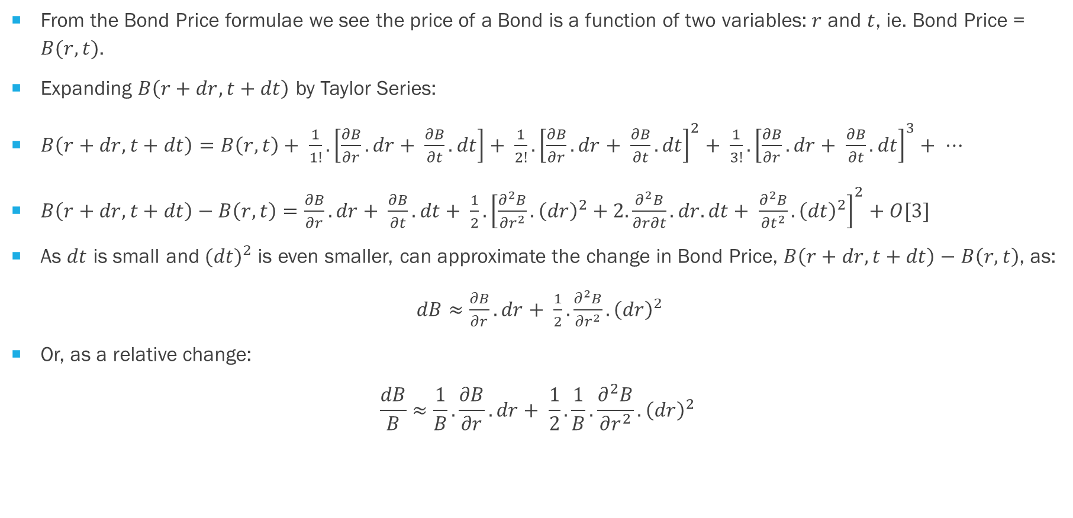
Changes in Bond Price
From the Bond Price formulae we see the price of a Bond is a function of two variables: $r$ and $t$, ie. Bond Price = $B(r, t)$.
Expanding $B\left(r+dr, t+dt\right)$ by Taylor Series:
$B\left(r+dr, t+dt\right)=B\left(r, t\right)+ \frac{1}{1!}.\left[\frac{∂B}{∂r}.dr+ \frac{∂B}{∂t}.dt\right]+ \frac{1}{2!}.{\left[\frac{∂B}{∂r}.dr+ \frac{∂B}{∂t}.dt\right]}^{2}+ \frac{1}{3!}.{\left[\frac{∂B}{∂r}.dr+ \frac{∂B}{∂t}.dt\right]}^{3}+ ⋯$
$B\left(r+dr, t+dt\right)−B\left(r, t\right)=\frac{∂B}{∂r}.dr+ \frac{∂B}{∂t}.dt+ \frac{1}{2}.{\left[\frac{∂^{2}B}{∂r^{2}}.{\left(dr\right)}^{2}+2.\frac{∂^{2}B}{∂r∂t}.dr.dt+ \frac{∂^{2}B}{∂t^{2}}.{\left(dt\right)}^{2}\right]}^{2}+O[3]$
As $dt$ is small and ${(dt)}^{2}$ is even smaller, can approximate the change in Bond Price, $B\left(r+dr, t+dt\right)−B\left(r, t\right)$, as:
$dB≈\frac{∂B}{∂r}.dr+ \frac{1}{2}.\frac{∂^{2}B}{∂r^{2}}.{\left(dr\right)}^{2}$
Or, as a relative change:
$$\frac{dB}{B}≈\frac{1}{B}.\frac{∂B}{∂r}.dr+ \frac{1}{2}.\frac{1}{B}.\frac{∂^{2}B}{∂r^{2}}.{\left(dr\right)}^{2}$$

Slide 5

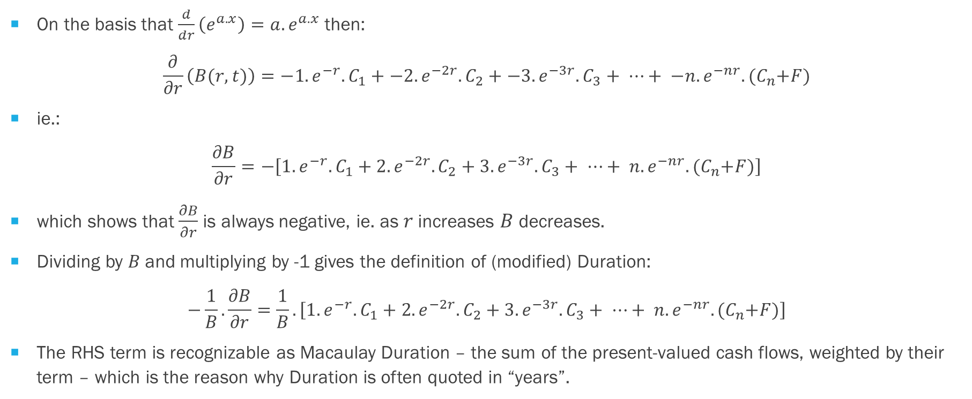
Duration $\left(−\frac{1}{B}.\frac{∂B}{∂r}\right)$
On the basis that $\frac{d}{dr}\left(e^{a.x}\right)=a.e^{a.x}$ then:
$$\frac{∂}{∂r}\left(B(r, t)\right)=−1.e^{−r}.C_{1}+−2.e^{−2r}.C_{2}+−3.e^{−3r}.C_{3}+ ⋯+ −n.e^{−nr}.{(C}_{n}+F)$$
ie.:
$$\frac{∂B}{∂r}=−\left[1.e^{−r}.C_{1}+2.e^{−2r}.C_{2}+3.e^{−3r}.C_{3}+ ⋯+ n.e^{−nr}.{(C}_{n}+F)\right]$$
which shows that $\frac{∂B}{∂r}$ is always negative, ie. as $r$ increases $B$ decreases.
Dividing by $B$and multiplying by -1 gives the definition of (modified) Duration:
$$−\frac{1}{B}.\frac{∂B}{∂r}=\frac{1}{B}.\left[1.e^{−r}.C_{1}+2.e^{−2r}.C_{2}+3.e^{−3r}.C_{3}+ ⋯+ n.e^{−nr}.{(C}_{n}+F)\right]$$
The RHS term is recognizable as Macaulay Duration – the sum of the present-valued cash flows, weighted by their term – which is the reason why Duration is often quoted in “years”.

Slide 6

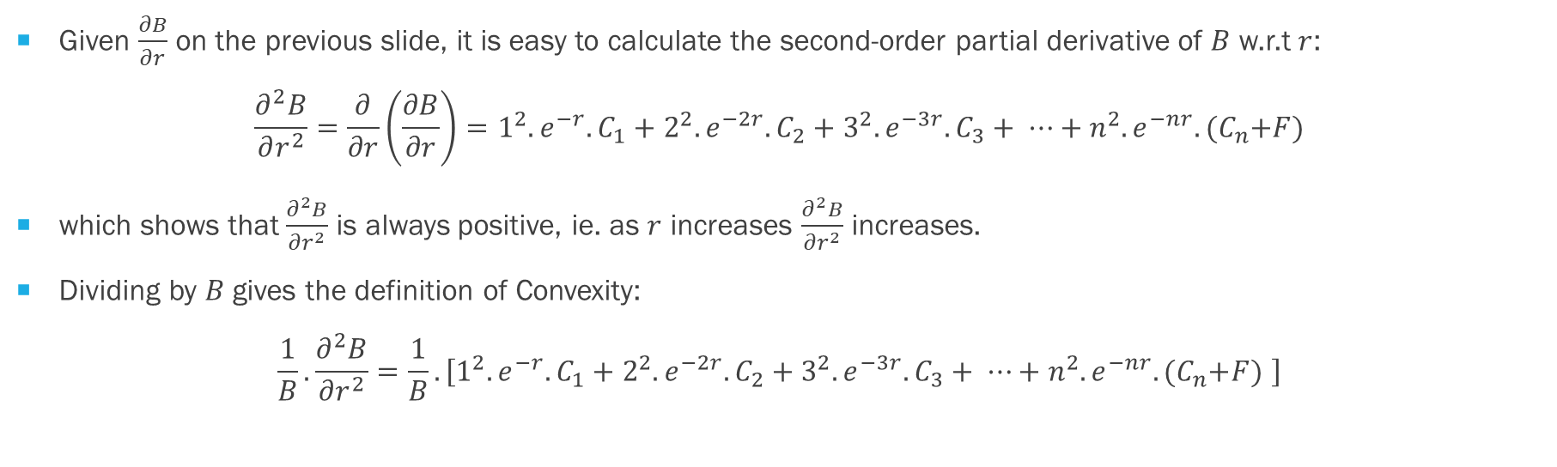
Convexity $\left(\frac{1}{B}.\frac{∂^{2}B}{∂r^{2}}\right)$
Given $\frac{∂B}{∂r}$ on the previous slide, it is easy to calculate the second-order partial derivative of $B$ w.r.t $r$:
$$\frac{∂^{2}B}{∂r^{2}}=\frac{∂}{∂r}\left(\frac{∂B}{∂r}\right)=1^{2}.e^{−r}.C_{1}+2^{2}.e^{−2r}.C_{2}+3^{2}.e^{−3r}.C_{3}+ ⋯+n^{2}.e^{−nr}.{(C}_{n}+F)$$
which shows that $\frac{∂^{2}B}{∂r^{2}}$ is always positive, ie. as $r$ increases $\frac{∂^{2}B}{∂r^{2}}$ increases.
Dividing by $B$ gives the definition of Convexity:
$$\frac{1}{B}.\frac{∂^{2}B}{∂r^{2}}=\frac{1}{B}.\left[1^{2}.e^{−r}.C_{1}+2^{2}.e^{−2r}.C_{2}+3^{2}.e^{−3r}.C_{3}+ ⋯+n^{2}.e^{−nr}.{(C}_{n}+F) \right]$$

Slide 7
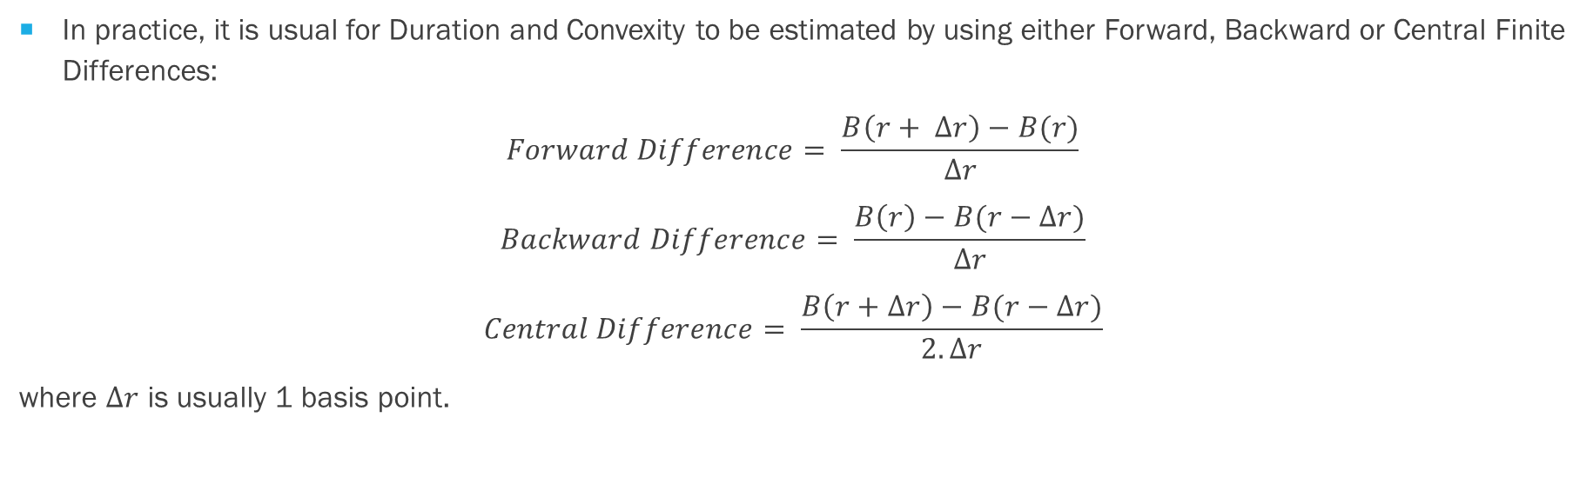
PRACTICALITIES
In practice, it is usual for Duration and Convexity to be estimated by using either Forward, Backward or Central Finite Differences:
$$Forward Difference= \frac{B\left(r+ ∆r\right)−B(r)}{∆r}$$
$$Backward Difference= \frac{B\left(r\right)−B(r−∆r)}{∆r}$$
$$Central Difference= \frac{B\left(r+∆r\right)−B(r−∆r)}{2.∆r}$$
where $∆r$ is usually 1 basis point.

Slide 8
Example
Using the example set out earlier;
 |  |  | Difference Method
 |  | Backward | Central | Forward
B(r + Δr) | 96.81913 |  | 96.81913 | 96.81913
B(r) | 96.84680 | 96.84680 |  | 96.84680 |  | ΔB/Δr (Forward) |  |  | -276.6476
B(r - Δr) | 96.87447 | 96.87447 | 96.87447 |  |  | ΔB/Δr (Backward) |  |  | -276.7287
ΔB |  | -0.02767 | -0.05534 | -0.02766 |  | ΔD |  |  | 0.08118
Δr |  | 0.00010 | 0.00010 | 0.00010 |  | Δr |  |  | 0.00010
B |  | 96.84680 | 96.84680 | 96.84680 |  | B |  |  | 96.84680
-1/B * ΔB/Δr |  | 2.85739 | 2.85697 | 2.85655 |  | 1/B*ΔD/Δr |  |  | 8.38208
True Duration (from formula) |  |  | 2.85697 |  |  | True Convexity (from formula) |  |  | 8.38208

